Slide 1
Rockbuster Stealth
2023 Sales Strategy
Brady BIssonette

Slide 2
Presentation Contents
Rockbuster Introduction
General Data Review
Data Analysis
Overall Findings
Recommendations

Slide 3
Rockbuster Introduction
Rockbuster Stealth LLC is a movie rental company that used to have stores around the world. Facing stiff competition from streaming services such as Netflix and Amazon Prime, the Rockbuster Stealth management team is planning to use its existing movie licenses to launch an online video rental service in order to stay competitive.
Our Goal in this analysis is to answer these Major Questions
Which movies contributed the most/least to revenue gain?
What was the average rental duration for all videos?
Which countries are Rockbuster customers based in?
Where are customers with a high lifetime value based?
Do sales figures vary between geographic regions?

Slide 4
General Data Overview
Total Films Offered: 1000
Average Film Length: 115.27
Total # of Customers: 599
Total # of Cities Served: 600
Total # Countries Served: 109
Total Film Revenue: $61,312.04
Average Rental Duration: 4.98
Average Rental Cost: 2.98

Slide 5
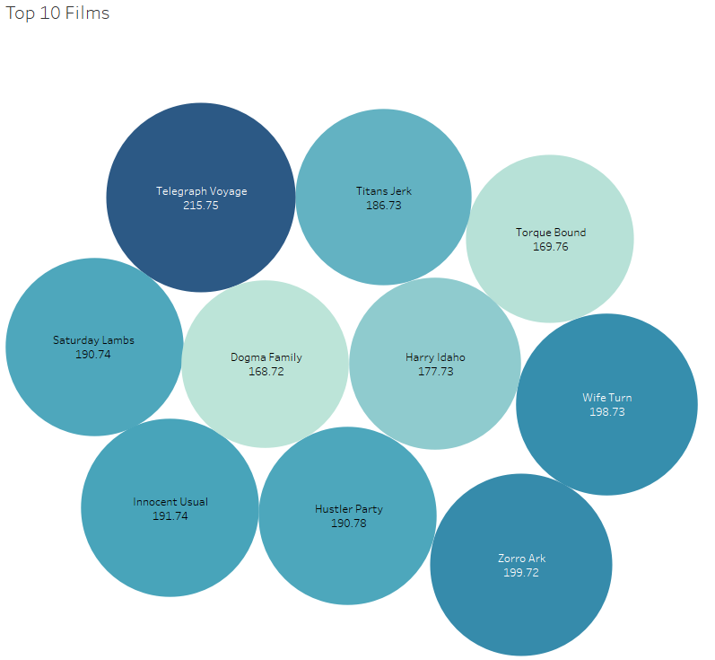
Data Analysis Top Films
The Top Revenue Generating Film was Telegraph Voyage follow by Zorro Ark

Slide 6
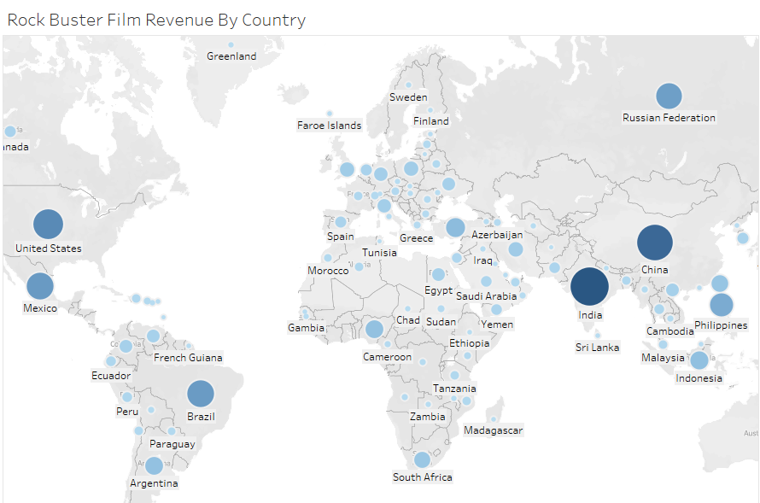
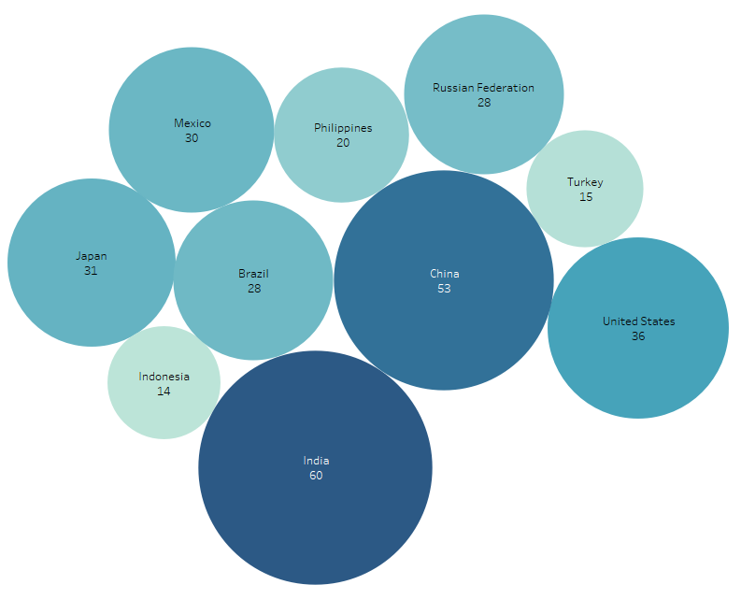
Data Analysis
India and China are the top two counties with the most revenue generated and largest number of customers with the US, Japan, and Mexico following
Top 10 Countries

Slide 7
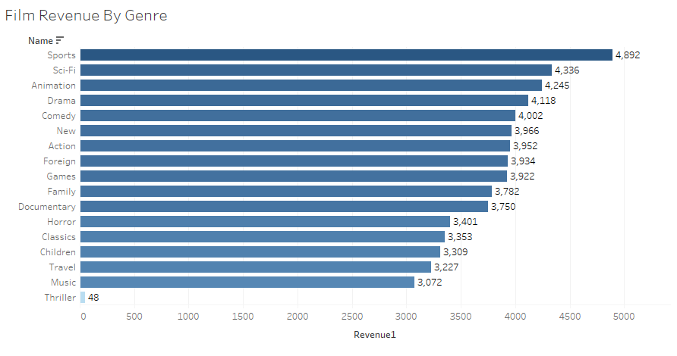
Data Analysis Popular Genres
Sports films performed the highest with a revenue of $4,892
Sci-Fi, Animation, Drama, and Comedy follow Sports Grossing over $4k each
Thriller was significantly low as the least purchase genre.

Slide 8

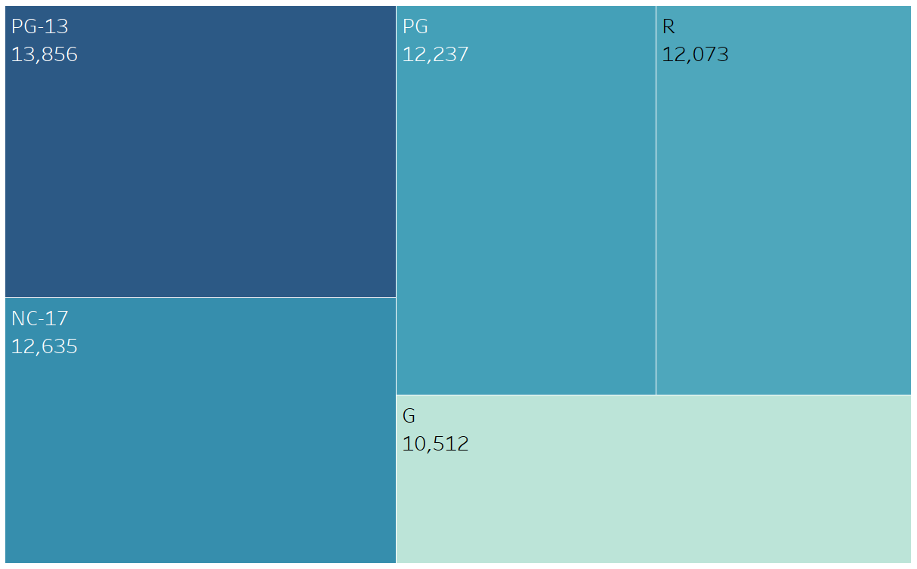
Data Analysis Top Ratings by Revenue
The top performing Rating group was PG-13 grossing $13,856

Slide 9
Data Analysis Top 5 Customers and Locations
Arlene Harvey, Abattur, India
Kyle Spurlock, Shanwei, China
Marlene Welch, Iwaki, Japan
Glen Talbert, Acua, Mexico
Clinton Buford, Aurora, United States
The top customer’s locations are fairly spread out but of these 5, 2 are taken from the Asian region.

Slide 10
Overall Findings
Telegraph Voyage, Zorro Ark, and Wife Turn were the top 3 films.
The Average Rental Cost was $2.98
The top 5 Countries with Rockbuster films were: India, China, United States, Japan, and Mexico.
The top five customers are from: Ambattur, Shanwei, Iwaki, Acua, and Aurora
The Sales figures do vary between regions with the Asia’s holding the highest Sales followed by the America’s then Europe

Slide 11
Recommendations
I recommend targeting further sales in the Asia region primarily on the genres of sports, sci-fi, animation, and drama.
Rockbuster should pursue increasing inventory on films the fall into IMDB ratings of either PG-13 or NC-17.
Rockbuster should consider offering rewards to high life-time value customers that have shown commitment to using Rockbuster films strengthening customer loyalty.
Lastly, I recommend removing thriller movies from the Rockbuster gallery as the genre is not supporting the business in any significant degree.

Slide 12
Sources
Tableau Visualiations: https://public.tableau.com/shared/XBC5T2868?:display_count=n&:origin=viz_share_link

